Slide 1
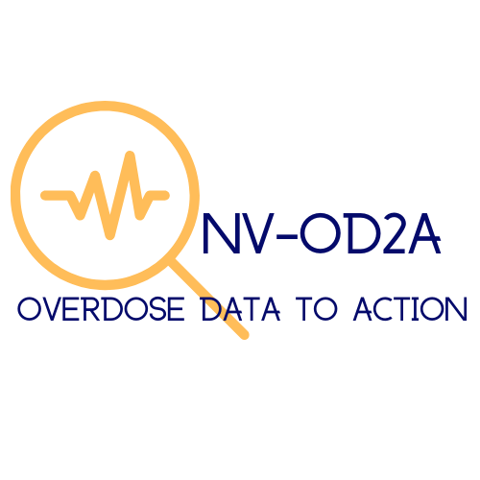
Drug Overdose Deaths of Unintentional/Undetermined Intent in Nevada – January to June, 2021:
436 deaths among Nevada residents - Statewide
Who died by drug overdose?
Top drugs listed as cause of death (COD)¹
What circumstances² were documented?
65% of deaths involved any opioids, 58% of deaths involved any stimulants, and 28% of deaths involved an opioid and stimulant.
Opioid and stimulant involvement in COD¹
77% of decedents had at least one potential opportunity for linkage to care prior to death or implementation of a life-saving action* at the time of overdose.
Nearly 1 in 4 who died by drug overdose were 25-34 years old, 65% were white, and 65% were male.
Data comes from the Nevada State Unintentional Drug Overdose Reporting System (SUDORS), which compiles information from death certificates, medical examiner/coroner reports, and toxicology results. Percentages are among decedents with known information. Abbreviations: NH: Non-Hispanic; COD (Cause of Death); Meth: Methamphetamine; Benzos: Benzodiazepines; IMFs: Illicitly manufactured fentanyl and fentanyl analogs. ¹Substances are not mutually exclusive. ²Circumstances represent evidence available in reports, and thus are likely underestimated. Percentages are among those with known circumstances. *Potential opportunity for life-saving action includes recent release from an institution within past month (prison/jail, treatment, hospital), previous nonfatal overdose, mental health diagnosis, ever treated for substance use disorder, bystander present when fatal overdose occurred, and fatal drug use witnessed. This publication was supported by the Nevada State Department of Health and Human Services through Grant Number NU17CE925001 from the Centers for Disease Control and Prevention. Its contents are solely the responsibility of the authors and do not necessarily represent the official views of the Department nor the Centers for Disease Control and Prevention. For questions, please contact NV OD2A epidemiologist Shawn Thomas at: shawnt@unr.edu

